Slide 1

Programming in C#

Slide 2
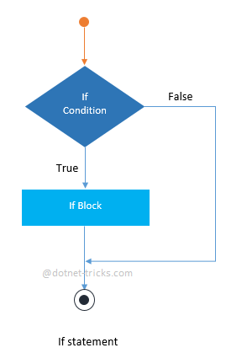
Decision Statements:
If statement:
An if statement consists of a boolean expression which is evaluated to a boolean value. If the value is true then if block is executed otherwise next statement(s) would be executed.

Slide 3
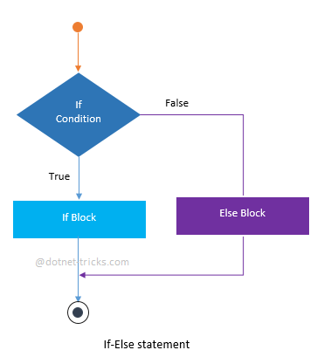
If – Else Statement :
An if-else statement consists of two statements – if statement and else statement. When the expression in an if-statement is evaluated to true then if block is executed otherwise the else block would be executed.

Slide 4
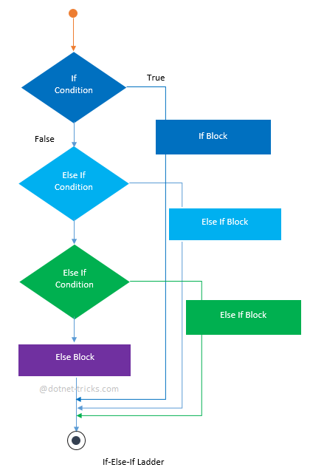
If-Else-If statement or ladder :
The If-Else-If ladder is a set of statements that is used to test a series of conditions. If the first if statement meet the result then code within the if block executes. If not, control passes to the else statement, which contains a second "if" statement.
If second one meet the result then code within the if block executes. This continues as a series of else if statements. A default else code block may execute when no condition has been evaluated to true.

Slide 5
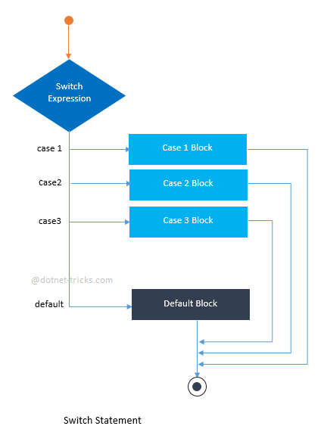
Switch Statement :
Switch statement acts as a substitute for long If-Else-If ladder that is used to test a series of conditions. A switch statement contains one or more case labels which are tested against the switch expression.

Slide 6
Jump Statements :
In C#, Jump statements are used to transfer control from one point to another point in the program due to some specified code while executing the program. There are five keywords in the Jump Statements:
Break
Continue
Goto
Return
Throw

Slide 7
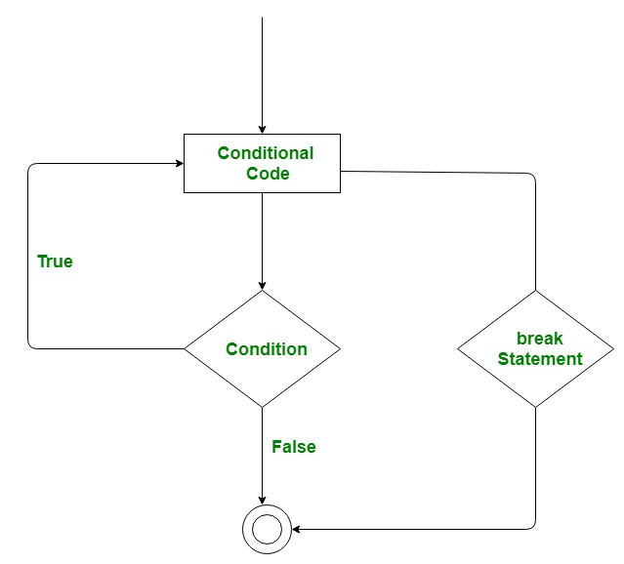
Break Statement :
The break statement is used to terminate the loop or statement in which it present. After that, the control will pass to the statements that present after the break statement, if available. If the break statement present in the nested loop, then it terminates only those loops which contains break statement.

Slide 8
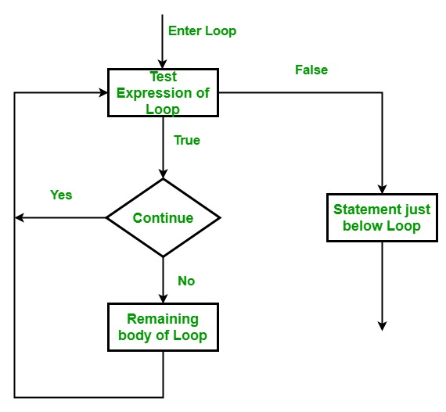
Continue Statement:
This statement is used to skip over the execution part of the loop on a certain condition. After that, it transfers the control to the beginning of the loop. Basically, it skips its following statements and continues with the next iteration of the loop.

Slide 9
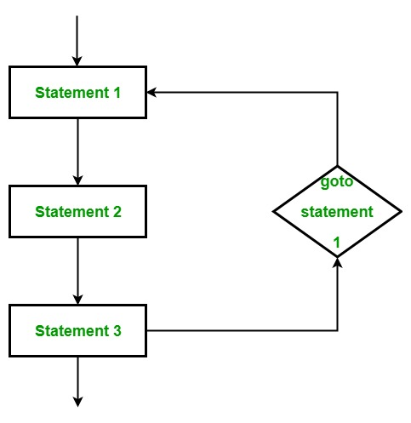
Goto Statement :
This statement is used to transfer control to the labeled statement in the program. The label is the valid identifier and placed just before the statement from where the control is transferred.

Slide 10
Return and Throw Statements:
Return:
This statement terminates the execution of the method and returns the control to the calling method. It returns an optional value. If the type of method is void, then the return statement can be excluded.
Throw:
This is used to create an object of any valid exception class with the help of new keyword manually. The valid exception must be derived from the Exception class.

Slide 11
Loops :
While loop:
Syntax:
While(condition)
{
//statements
}
Do While loop:
Syntax:
do
{
//statements
}while(condition);

Slide 12
Loops :
For Loop :
Syntax:
for(initialization, condition, increment)
{
//Statements
}
Foreach Loop:
Syntax:
Foreach( <type> in Array) //Element-wise iteration
{
//Statements
}

Slide 13
Loops :
Infinite For loop:
Syntax :
For(;;)
{
//Statements
}
Infinite While loop:
Syntax :
While(true)
{
//Statements
}

Slide 14
Methods in C#:
A method is a group of statements that together perform a task. A method is a block of code which only runs when it is called.
Define the method
Call the method
Syntax To Define a Method:
<Access Specifier> <Return Type> <Method Name>(Parameter list){
//Statements
}

Slide 15
Methods in C#:
Access Specifier :
This determines the visibility of a variable or a method from another class.
Public : It specifies that access is not restricted.
Private : It specifies that access is limited to the containing type.
Protected : It specifies that access is limited to the containing class or in derived class.
Internal : It Specifies that access is limited to the current assembly.
Protected Internal : It Specifies that access is limited to the current assembly or types derived from the containing class.
Return Type:
A method may return a value. The return type is the data type of the value the method returns. If the method is not returning any values, then the return type is void.
Method Name:
Method name is a unique identifier and it is case sensitive.
Parameter List:
The parameter list refers to the type, order, and number of the parameters of a method. Parameters are optional; that is, a method may contain no parameters.

Slide 16
Dictionaries in C#:
Dictionary is a collection of keys and values in C#. Dictionary is included in the System.Collection.Generics namespace.
Syntax:
Dictionary <type, type> d = new Dictionary <type, type>();
Methods:
Add : d.Add( key, value); //Adds a key-value pair to the dictionary
ContainsKey : d.ContainsKey(key); //Checks if there is a required key or not
Remove : d.Remove(key); //Removes the key-value pair
Clear : d.Clear(); //Clears the dictionary

Slide 17
Dictionaries in C#:
Properties:
Values : d.Values //Returns the collection of values.
Keys : d.Keys //Returns the collection of keys.
Count :d.Count //Returns the number of elements in the Dictionary.
Item[] :item[key] //Returns value associated with the Key.

Slide 18
Arrays :
A variable is used to store a literal value, where as an array is used to store multiple literal values.
An array is the data structure that stores a fixed number of literal values (elements) of the same data type.
In C#, an array can be of three types:
Single-dimensional array
Multidimensional array and
Jagged array.

Slide 19
Single-dimensional Array :
Declaration:
int[] evenNums; // integer array
string[] cities; // string array
int[] evenNums = new int[5]{ 2, 4, 6, 8, 10 };
string[] cities = new string[3]{ "Mumbai", "London", "New York" }; //Initialization while declaring
Initialization & Accessing :
evenNums[0] = 12;
Cities[1] = “Delhi”;
Console.WriteLine(evenNums[0]);

Slide 20
Contd…
Methods :
Array.Sort(evenNums);
Array.Reverse(evenNums);
Array.BinarySearch(array ,element);
Array.Clear(array ,start_index, length);
Array.Copy(source,destination,length);
Array.Empty(array); //returns empty array
Array.Exists(array, element); //(Predicate error)

Slide 21
Multidimensional Array :
Arrays can have more than one dimension. For example, the following declaration creates a two-dimensional array of four rows and two columns.
int[,] array = new int[4, 2];
The following declaration creates an array of three dimensions, 4, 2, and 3.
int[,,] array1 = new int[4, 2, 3];
Assigning a value to a particular array element.
array[2, 1] = 25;
Getting value of a particular element and assigns it to a variable.
int ele =array[2,1];

Slide 22
Jagged Array :
A jagged array is an array whose elements are arrays, possibly of different sizes. A jagged array is sometimes called an “array of arrays”.
The following is a declaration of a single-dimensional array that has three elements, each of which is a single-dimensional array of integers:
int[][] jaggedArray = new int[3][];
jaggedArray[0] = new int[5];
jaggedArray[1] = new int[4];
jaggedArray[2] = new int[2];
It is also possible to use initializers to fill the array elements with values, in which case you do not need the array size. For example:
jaggedArray[0] = new int[] { 1, 3, 5, 7, 9 };
jaggedArray[1] = new int[] { 0, 2, 4, 6 };
jaggedArray[2] = new int[] { 11, 22 };

Slide 23
Lists in C# :
The List<T> is a collection of strongly typed objects that can be accessed by index and having methods for sorting, searching, and modifying list.
It comes under System.Collections.Generic namespace.
List<T> can contain elements of the specified type.
Elements can be added using the Add(), AddRange() methods or collection-initializer syntax.
Elements can be accessed by passing an index e.g. myList[0]. Indexes start from zero.
Count property returns the number of elements exists in the List.
To pass List as an argument to a method , we follow the syntax
public static void Display<T>(List<T> list)

Slide 24
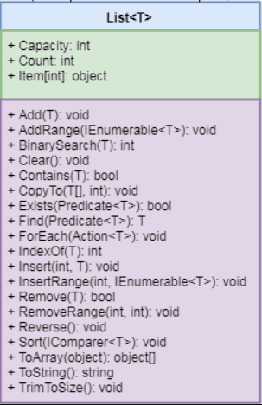
Class Hierarchy :
Add : To add elements to the list.
AddRange : Adds elements of the specified collection at the end of a List<T>.
Clear : Removes all the elements from a List<T>.
Contains : Checks whether the specified element exists or not in a List<T>.
Insert : Inserts an element at the specified index in a List<T>.
Remove : Removes the first occurrence of the specified element.

Slide 25
ArrayList in C# :
In C#, the ArrayList is a non-generic collection of objects whose size increases dynamically. It is the same as Array except that its size increases dynamically.
An ArrayList can be used to add unknown data where you don't know the types and the size of the data.
An ArrayList can be created by using the syntax –
ArrayList arlist = new ArrayList(); or
var arlist = new ArrayList();
Use the Add() method or object initializer syntax to add elements in an ArrayList.
We can access the elements in the ArrayList by using the index of the elements.

Slide 26
ArrayList Properties :
Properties | Description
Capacity | Gets or sets the number of elements that the ArrayList can contain.
Count | Gets the number of elements actually contained in the ArrayList.
IsFixedSize | Gets a value indicating whether the ArrayList has a fixed size.
IsReadOnly | Gets a value indicating whether the ArrayList is read-only.
Item | Gets or sets the element at the specified index.

Slide 27
ArrayList Methods :
Methods | Description
Add()/AddRange() | Add() method adds single elements at the end of ArrayList. AddRange() method adds all the elements from the specified collection into ArrayList.
Insert()/InsertRange() | Insert() method insert a single elements at the specified index in ArrayList. InsertRange() method insert all the elements of the specified collection starting from specified index in ArrayList.
Remove()/RemoveRange() | Remove() method removes the specified element from the ArrayList. RemoveRange() method removes a range of elements from the ArrayList.
RemoveAt() | Removes the element at the specified index from the ArrayList.
Sort() | Sorts entire elements of the ArrayList.
Reverse() | Reverses the order of the elements in the entire ArrayList.
Contains | Checks whether specified element exists in the ArrayList or not. Returns true if exists otherwise false.
Clear | Removes all the elements in ArrayList.
CopyTo | Copies all the elements or range of elements to compitible Array.
GetRange | Returns specified number of elements from specified index from ArrayList.
IndexOf | Search specified element and returns zero based index if found. Returns -1 if element not found.
ToArray | Returns compitible array from an ArrayList.

Slide 28
Structures in C#:
A structure is a value type data type. It helps you to make a single variable hold related data of various data types. The struct keyword is used for creating a structure.
Structures can have methods, fields, indexers, properties, operator methods, and events.
Unlike classes, structures cannot inherit other structures or classes.
Structures cannot be used as a base for other structures or classes.
When you create a struct object using the New operator, it gets created and the appropriate constructor is called. Unlike classes, structs can be instantiated without using the New operator.
For example, here is the way you can declare the Book structure −
struct Books {
public string title;
public string author;
public string subject;
};

Slide 29
Enumerations in C# :
An enumeration is a set of named integer constants. An enumerated type is declared using the enum keyword.
C# enumerations are value data type. In other words, enumeration contains its own values and cannot inherit or cannot pass inheritance.
The general syntax for declaring an enumeration is
enum <enum_name> { enumeration list };
The enum_name specifies the enumeration type name.
The enumeration list is a comma-separated list of identifiers.

Slide 30
Inheritence in C# :
Its a mechanism of consuming the members of one class in another class by establishing parent/child relationship between classes.

